Slide 1
Data Modeling

Slide 2
Class Objectives
By the end of today’s class, you will:
Apply data modeling techniques to database design.
Normalize data.
Identify data relationships.
Create visual representations of a database through entity relationship diagrams.

Slide 3
Data Normalization

Slide 4
Data Normalization
Data normalization is the process of restructuring data to a set of “normal forms.”
This reduces and eliminates data redundancy and inconsistencies.
Three most common forms:
First normal form (1NF)
Second normal form (2NF)
Third normal form (3NF)
There are even more levels!

Slide 5
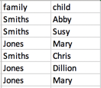
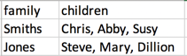
First Normal Form (1NF)
Each field in a table row should contain a single value.
Each row is unique.
Rows can have fields that repeat.
Whole rows do not fully match.
First Normal Form
Raw Data
Normalization

Slide 6
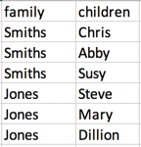
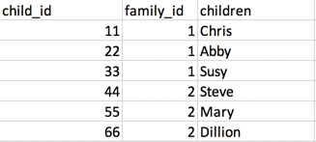
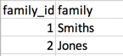
Second Normal Form (2NF)
Data is in first normal form.
Duplicated data is split into separate tables.
Primary keys identify unique rows of data.
Data in 1NF
Child Table
2NF Normalization
Family Table

Slide 7
Transitive Dependence
Transitive dependence is a column value’s reliance on another column through a third column.
Transitive:
If X > Y and Y > Z, then X> Z.
Dependence:
One value relies on another.
Examples: city relies on ZIP code, age relies on birthday
For example:
Say you have three columns in a table: StoreName, OwnerAddress, and OwnerName.
OwnerName and OwnerAddress rely on the the StoreName.
OwnerAddress also relies on the OwnerName.
So, OwnerAddress relies on the StoreName via the OwnerName.

Slide 8
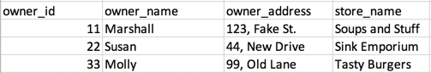
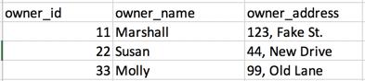
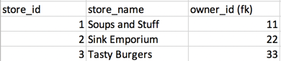
Third Normal Form (3NF)
Must be in second normal norm
Contains non-transitively dependent columns
3NF Normalization

Slide 9
Foreign Keys

Slide 10
Foreign Keys
Before we can get data into third normal form, we need to understand the concept of foreign keys.
Foreign keys reference the primary key of another table.
Foreign keys can have a different name and do not need to be unique.
Primary Key
Foreign Key
Primary Key

Slide 11
Data Relationships

Slide 12
Data Relationhsips
One to One
One to Many
Many to Many

Slide 13
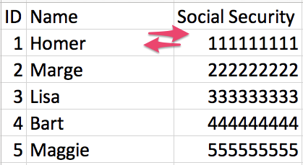
One-to-One Relationship
Each item in one column is linked to only one item from the other column.
Here, each member of the Simpson family has only one Social Security number.
Each Social Security number can be assigned only to one person.

Slide 14
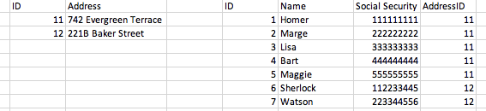
One-to-Many Relationship
Here are two tables: one for people, and another for addresses.
Each person has only one address.
However, each address can be associated with multiple people.

Slide 15
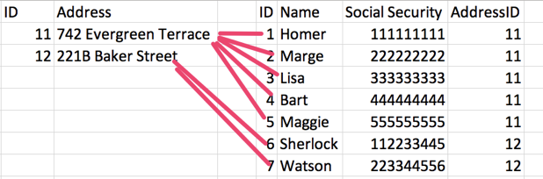
One-to-Many Relationship
The two tables joined would look like this.
Each person has an address.
Each address can be associated with multiple people.

Slide 16
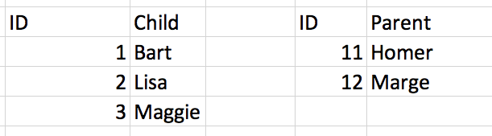
Many-to-Many Relationship
Each child here has more than one parent.
Each parent has more than one child.

Slide 17
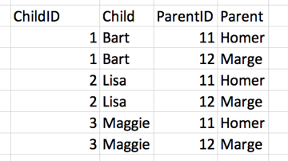
Many-to-Many Relationship
Each child can have more than one parent.
Each parent can have more than one child.
The two tables are joined in a junction table.

Slide 18
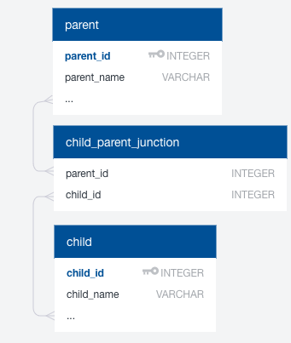
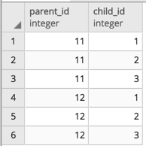
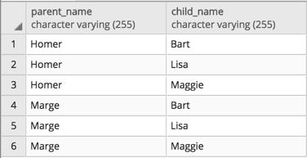
Junction Table
Join child and parent table through junction table
A junction table contains many parent_ids and child_ids.

Slide 19
Entity Relationship Diagrams

Slide 20
Entity Relationship Diagrams (ERDs)
An Entity Relationship Diagram provides a visual method of modeling data.
Entities, their data types, and relationships are all illustrated in the diagram.
There are three models used when creating diagrams:
Conceptual: Basic information containing table and column names
Logical: Slightly more complex than conceptual models, with IDs and data types defined
Physical: The blueprint of the database, reflecting physical relationships between entities

